Slide 1
genre and teaching and learning cycle
Topic 5 - EDF 1205

Slide 2
why do we teach writing as part of an English curriculum?
To organise our thinking
To remember/reflect
To create
To retell/review
To inform/instruct
To persuade
Other?
Notes:
Explain project

Slide 3
We build texts from words to CLAUSES TO sentences to paragraphs to genres (text types)
WORD LEVEL
AAARRRRrrrggggghhhhhh
PHRASE LEVEL
Spinning chair takes them home
SENTENCE LEVEL
What is the last lie you told?
TEXT LEVEL
The Hunger Games (novel/film script)

Slide 4
Children become aware
That they can expand their writing to achieve an increasing range of social purposes
We call these social purposes GENRES or TEXT TYPES
We recognise a genre/text type from the implicit rules it follows

Slide 5
SOME text typeS, or genre examples for these writing purposes:
To organise our thinking (notes, lists)
To remember/reflect (journals, reflections)
To create (creative/narrative/personal writing)
To retell/review (reports, reviews)
To inform/instruct (recipes, instructions, newspaper articles)
To persuade (ads, speeches, letters to the editor, tweets)

Slide 6
And then we have modes of texts
Oral
Written
Digital?
Gestural
Aural

Slide 7
.. And forms of texts
Report
Speech
Letter
Presentation
Text message/email/tweet
Video
Journal entry
Novel
Poem
Short story

Slide 8
Mixture of Genres
In reality, texts are often mixtures of genres, and this needs to be discussed with students. However, Genre Theory aims to explain a way for teachers to equip students in primary school with the understanding and skills necessary to use culturally powerful ways of writing.

Slide 9
So how do we teach genre?
Let’s watch: Teaching Learning Cycle ‘Ross’
An Introduction to the Teaching and Learning cycle
Notes:
Class discussion
We’ll be looking into this curriculum cycle in further detail throughout the rest of the semester

Slide 10
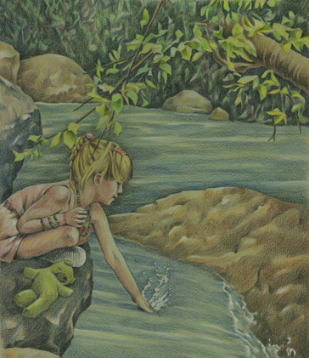
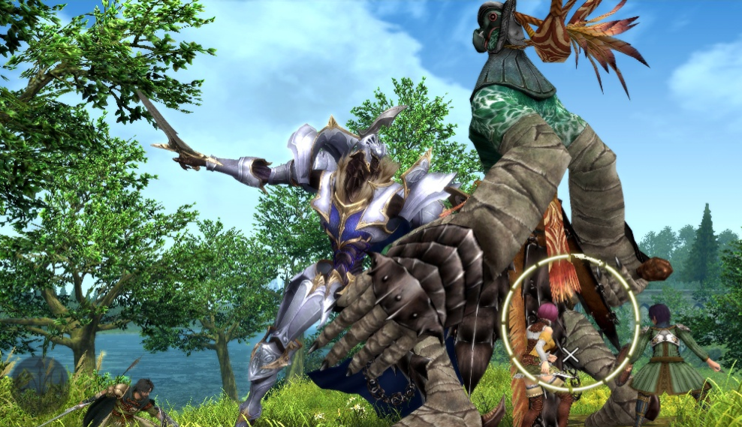
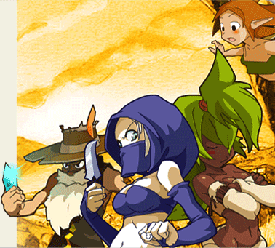
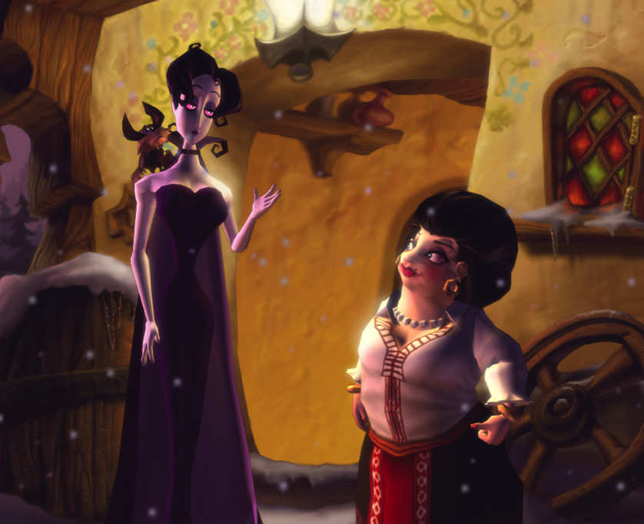
WRITING STORIES:
USING LANGUAGE TO BUILD A STORY WORLD

Slide 11
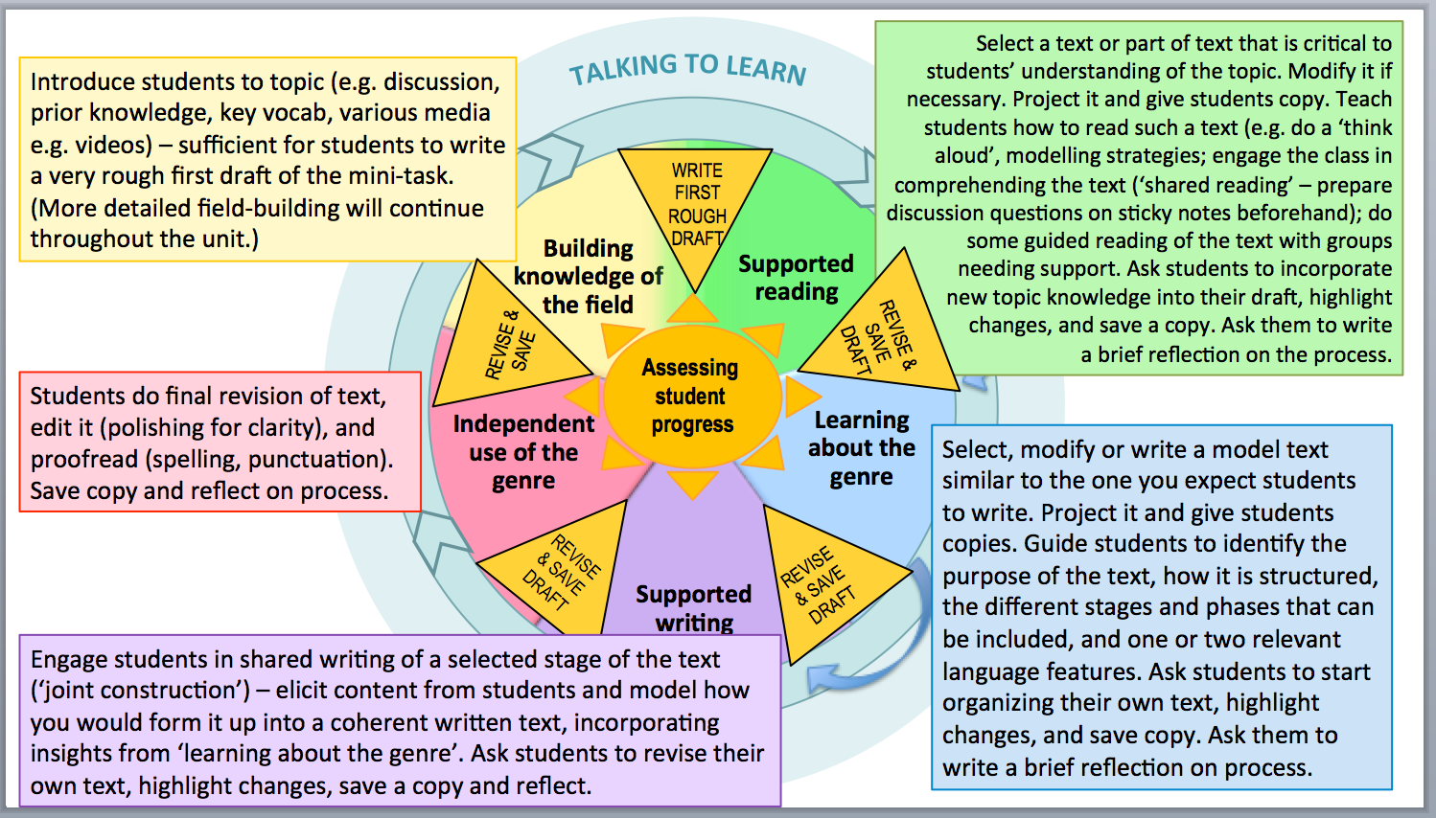

Slide 12
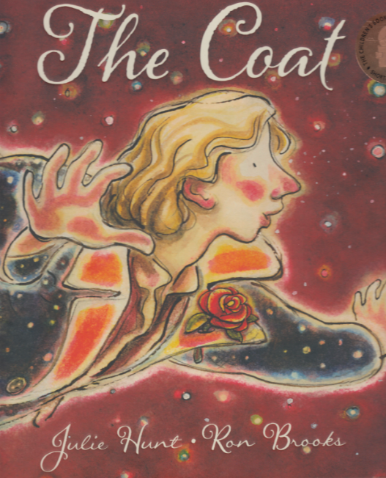
Allen and Unwin

Slide 13
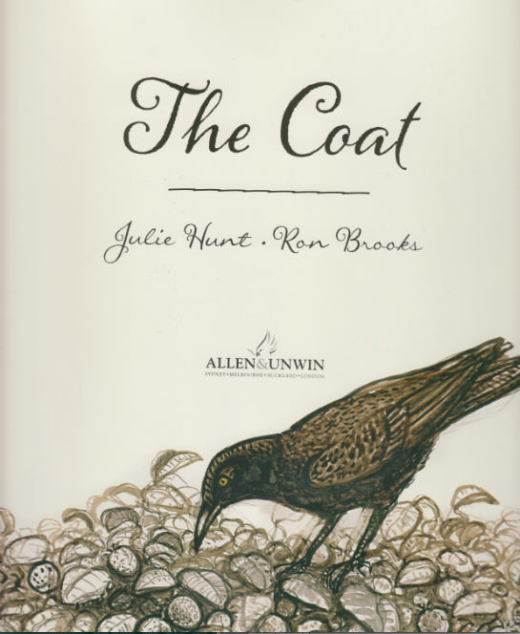
Notes:
Let’s read the story

Slide 14
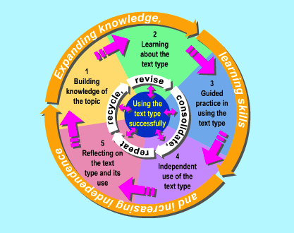
Identifying some of the phases & their function
Developing some tools
Identifying the main stages & their function
Learning about the genre
Further extension
Building knowledge of the field
Guided practice in using the genre
Independent use of the genre
Assess
students’
progress
CURRICULUM CYCLE

Slide 15
By providing students with a few simple tools to investigate the language of stories, we enable them:
To interpret the THEME of the story by looking at how certain meanings are given significance in developing a message.
To explore the basic elements of PLOT by identifying how the story moves through typical stages such as Orientation, Complication and Resolution
To understand how the story ‘works’ in greater detail by identifying the PHASES within the stages

Slide 16
To observe how various aspects of SETTING (natural, built, time, historical, social) participate in developing the meaning of the story
To investigate how CHARACTERS are brought to life through description of their physical characteristics and personality along with how they behave (doing, thinking, feeling, interacting).

Slide 17
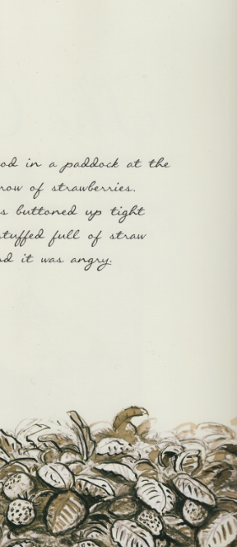
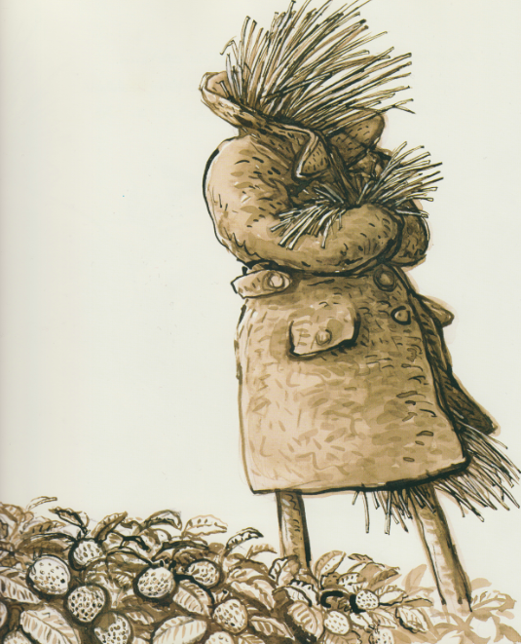
ORIENTATION
The coat stood in a paddock at the end of a row of strawberries.
It was buttoned up tight and stuffed full of straw and it was angry.
Initial setting
Introduction to character

Slide 18
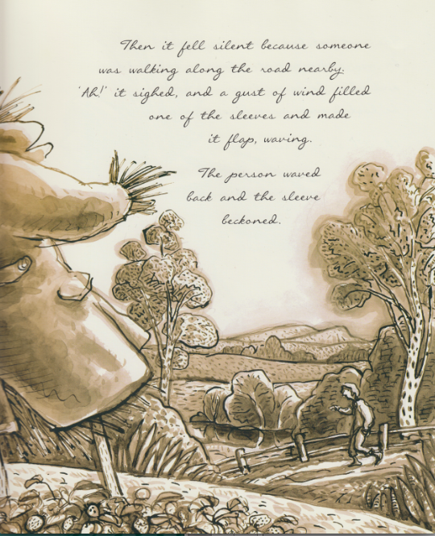
Then it fell silent because someone was walking along the road nearby.
‘Ah!’ it sighed,
and a gust of wind filled one of the sleeves
Event/’happening’
and made it flap, waving.
The person waved back and the sleeve beckoned.

Slide 19
Typical phases within the stages of a narrative:
Events
Representing those phases in a story where something happens. They typically continue the action of the story.
They can be brief or extended. Some events occur in direct reaction to the Complication or to a problem.
Language resources to represent events include:
action verbs to depict doings and happenings: ‘Sadie scrambled to her feet, waved her gloves at the car, and staggered off into the night. A sick feeling of dread churned in her stomach. … Sadie stretched out her hands in the soupy dark as if she could grope from one fistful of shadow to the next. The night thrummed with rustlings and scamperings …’

Slide 20
ACTIVITY (Text level)
What is the complication in The Coat?
Is there a different complication for the man and the coat?
How are the complications resolved?
How would you describe the complication? (See ‘Types of complications’ below.)
Does the complication involve decision points in the growth of the character?

Slide 21
Identifying the Complication

Slide 22
Complication – Man feeling disappointed and unwilling to take initiative; coat feeling angry at not being useful
Resolution – Man and coat become one, fulfilling the man’s potential and giving the coat back its purpose

Slide 23
Identifying some of the phases & their function
Developing some tools
Identifying the main stages & their function
Learning about the genre
Further extension
Building knowledge of the field
Guided practice in using the genre
Independent use of the genre
Assess
students’
progress
CURRICULUM CYCLE

Slide 24
DESIGNING THE SETTING

Slide 25
REPRESENTING ‘WHAT’S GOING ON’ IN THE STORY
SETTING- think about the following for ‘The Coat’
How does the author represent the physical setting of the story (the geographical setting and the built setting)?
How does the author represent the historical setting of the story?
How does the author create a particular social setting?
What kind of ‘world’ is created (eg fantasy, dystopian, science fiction, adventure, romance)?
How do these settings change as the story develops?
What language (and visual) resources are used in developing the setting?
Language focus: Circumstances of place

Slide 26
Changes in the setting

Slide 27
DEVELOPING THE CHARACTERS

Slide 28
REPRESENTING ‘WHAT’S GOING ON’ IN THE STORY
CHARACTER DEVELOPMENT
How does the author describe the physical attributes of the characters? (eg what they look like, what they wear)
How does the author describe the personality of the characters? (eg what they do, how they behave, how they interact with others, what they think and feel)
How does the author develop the characters over time? How/why do they change?
What language resources are used in developing the characters?
Language focus: Participants (taking the grammatical form of noun groups and adjective groups) and different types of Processes (action, sensing, saying, relating)

Slide 29
Authors make very deliberate choices in developing their characters:
How many characters? What relationships do they form?
Who will be the central character (the protagonist)? What age? Which gender? What qualities? Sympathetic or unsympathetic?
will there be an antagonist (the person or force/s working against the central character)?
How will the author’s choices contribute towards the development of the complication?
how will empathy for the characters be developed?
How will the character be fleshed out? A stock character, for example, needs little development (eg Mistress Crow, The Fox) as we are familiar with them already as stereotypes. A flat character is defined by a single quality and is often found in short stories as there is not much opportunity to develop the characters. A rounded character is a more complex individual.

Slide 30
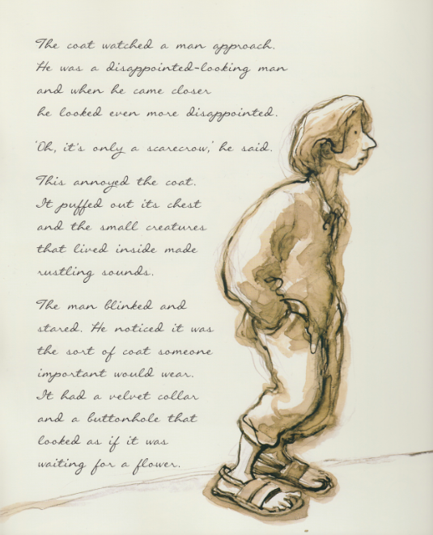
The coat watched the man approach.
He was a disappointed-looking man
and when he came closer
he looked even more disappointed.
‘Oh, it’s only a scarecrow,’
he said.
Introduction to character
Reaction
This annoyed the coat.
It puffed out its chest
and the small creatures that lived inside made rustling sounds.
The man blinked
and stared.

Slide 31
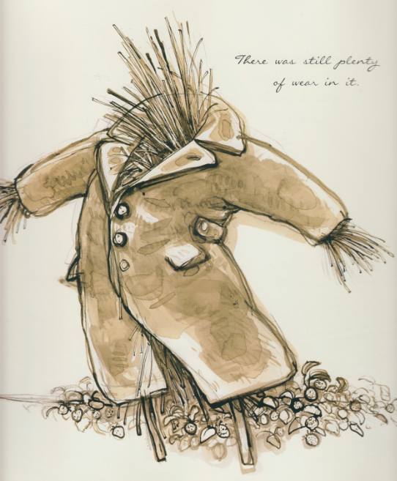
Character description
He noticed
it was the sort of coat someone important would wear.
It had a velvet collar and a buttonhole that looked as if it was waiting for a flower.
There was still plenty of wear in it.

Slide 32
The importance of feelings in developing the theme of the story.

Slide 33
Assessment Task 2a
Details of task:
Part A: Curriculum Plan (50%)
In a small group, collaboratively design a curriculum plan based on the teaching-learning cycle. The plan will involve scaffolding primary students as they create a story picture book. As part of the design process your group will compose your own story book so that you can experience what is involved and you will have a model (both of the process and the product) to share with the primary students.
As part of the inquiry project, you will be keeping a reflective journal to document your learning as you develop your curriculum plan, compose your story picture book and undertake reading.

Slide 34
Picture Story Book Guidelines
Please consider a format for your picture story book that can be shared with your tutors through moodle or as a website link
Your picture storybook should take 3-5 minutes to read.

Slide 35
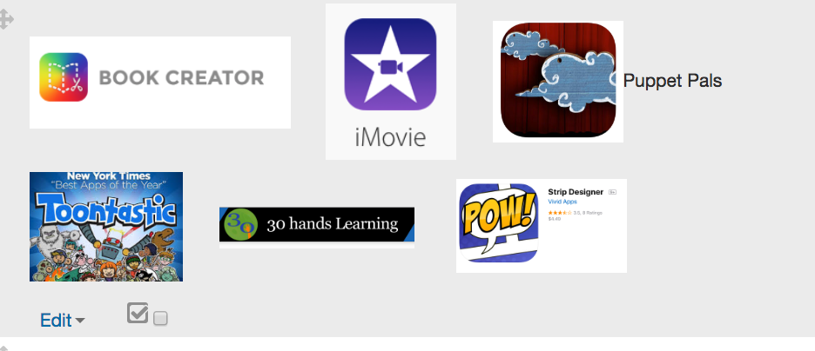
Explore some digital tools you could use to create your picture book: IOS apps – SEE Moodle
Some digital tools you could use to create your picturebook – web-based tools

Slide 36
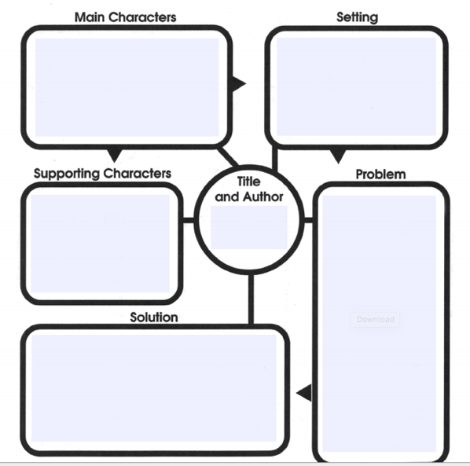
Assessment Task 2A Small group ACTIVITY
In the same small groups you worked in for Assessment Task 1b:
- Begin to create your picture
story book
- Remember to document how you
worked as a group in your
google doc
-You can use your digital story
map as a guide or create a new
story
Notes:
20 minutes in class time for small group work

Slide 37
FOR NEXT WEEK
CHANGE IN TIME
Guest Speakers

