Slide 1
Topic 10 – supported reading
EDF 1205: Week 10. 2020

Slide 2
This week we will:
revisit the teaching-learning curriculum cycle
explore approaches for supported reading specifically looking at:
Shared reading
Small group work
Using language as a resource
We will continue small group work on Assessment Task 2

Slide 3
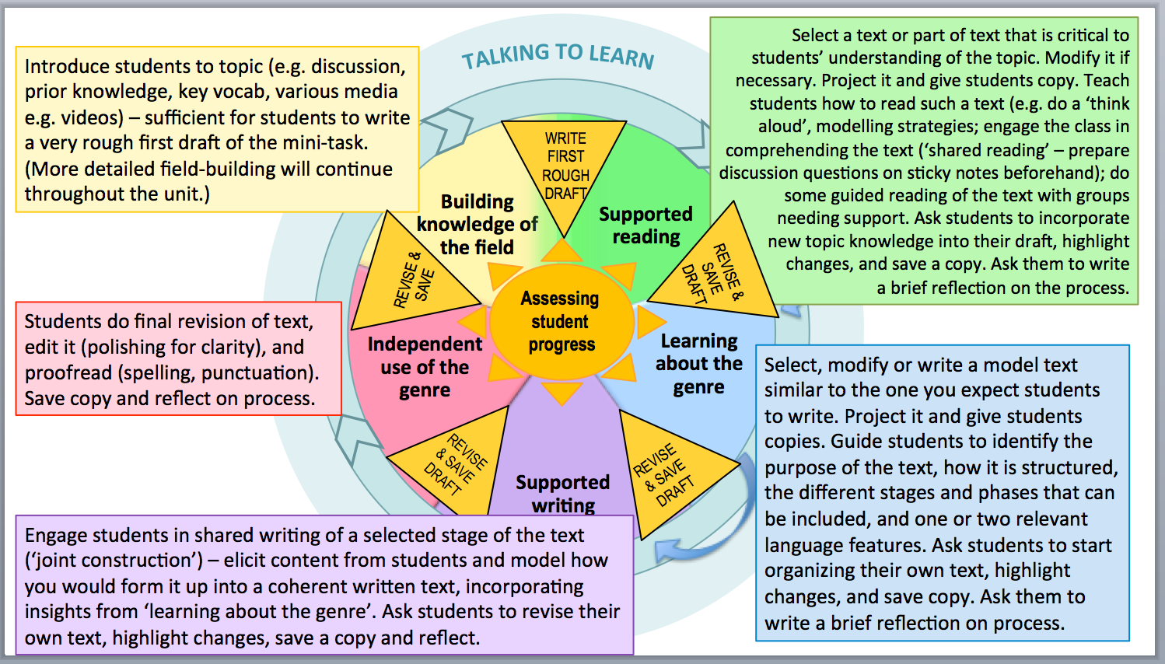
Teaching-Learning curriculum cycle

Slide 4
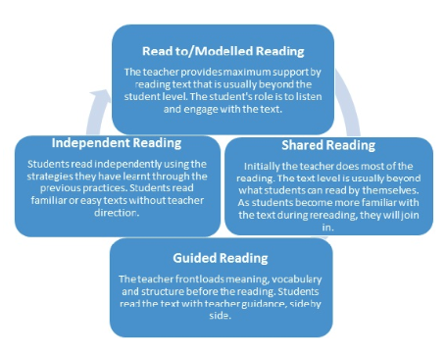
Teachers can use a suite of practices to support the teaching of reading. Initially, the focus of the reading is on meaning and enjoyment. Then teachers reread the text to explicitly demonstrate reading strategies and engage in problem solving using meaning, structure and visual information.
Ref: DET Literacy Teaching Toolkit

Slide 5
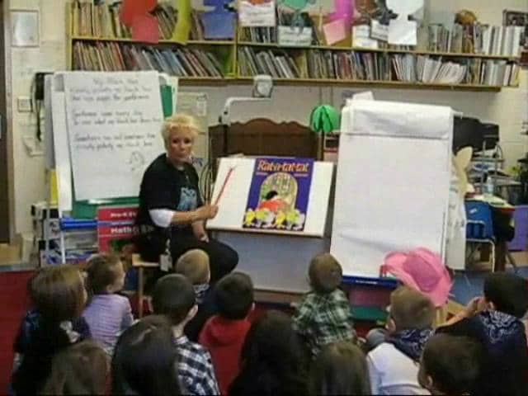
Shared Reading
Shared reading often involves the teacher reading (often an enlarged) text leading the students to apply reading skills and strategies previously introduced and to observe features of the text (e.g, the text structure and language features) often in preparation for writing a similar text.

Slide 6
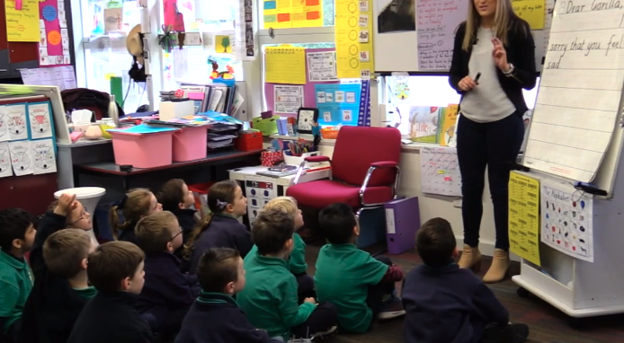
Grouping Practices
Individual
Small group
Whole Class
Provides opportunities to differentiate instruction

Slide 7
Small Group Work
Group B (1/2 class)
Listen to Podcast: ABC Radio National
Lynley Dodd: Children’s Author
Group A (1/2 class)
Shared Reading with Tutor
Listen to the Podcast –available on Moodle(bottom of Week 10)
Read some Lynley Dodd books
Consider your own illustrations for you picture story books
Where have your ideas come from?
What language are you using to describe your illustrations?

Slide 8
Shared Reading Procedure
select a text that contains appropriate challenges and supports for students
discuss and establish students’ prior knowledge of the topic
state the purpose of the text
share the learning intentions and the success criteria with the students encourage students to predict the text from the cover, title, and illustrations
encourage students to talk about the text and the language features of the text and
Discuss meanings in the text relating them to their own experiences
identify and discuss with students the conventions of the narrative genre
How is the theme similar to that of ‘The Coat’?
Rewrite sentences/phrases using different describing words e.g. ‘you are brave, you are strong’; ‘her arms light, her heart soaring’. (from Girl On Wire)

Slide 9
Shared reading provides opportunities for the teacher to:
expand vocabulary
read fluently, with expression and confidence
promote pleasure and enjoyment with texts
demonstrate decoding and comprehension strategies
demonstrate concepts of print such as left to right, return sweep, top to bottom, left page before right page (See VCAA Glossary: Concepts about Print, Return Sweep)
demonstrate how to use meaning, structure and visual information cues to assist reading (See Running Records: Sources of information)
teach phonics and phonemic awareness, see Shared Reading lesson: Identifying and generating rhyming words , Shared Reading lesson: blend and segment onset and rime)

Slide 10
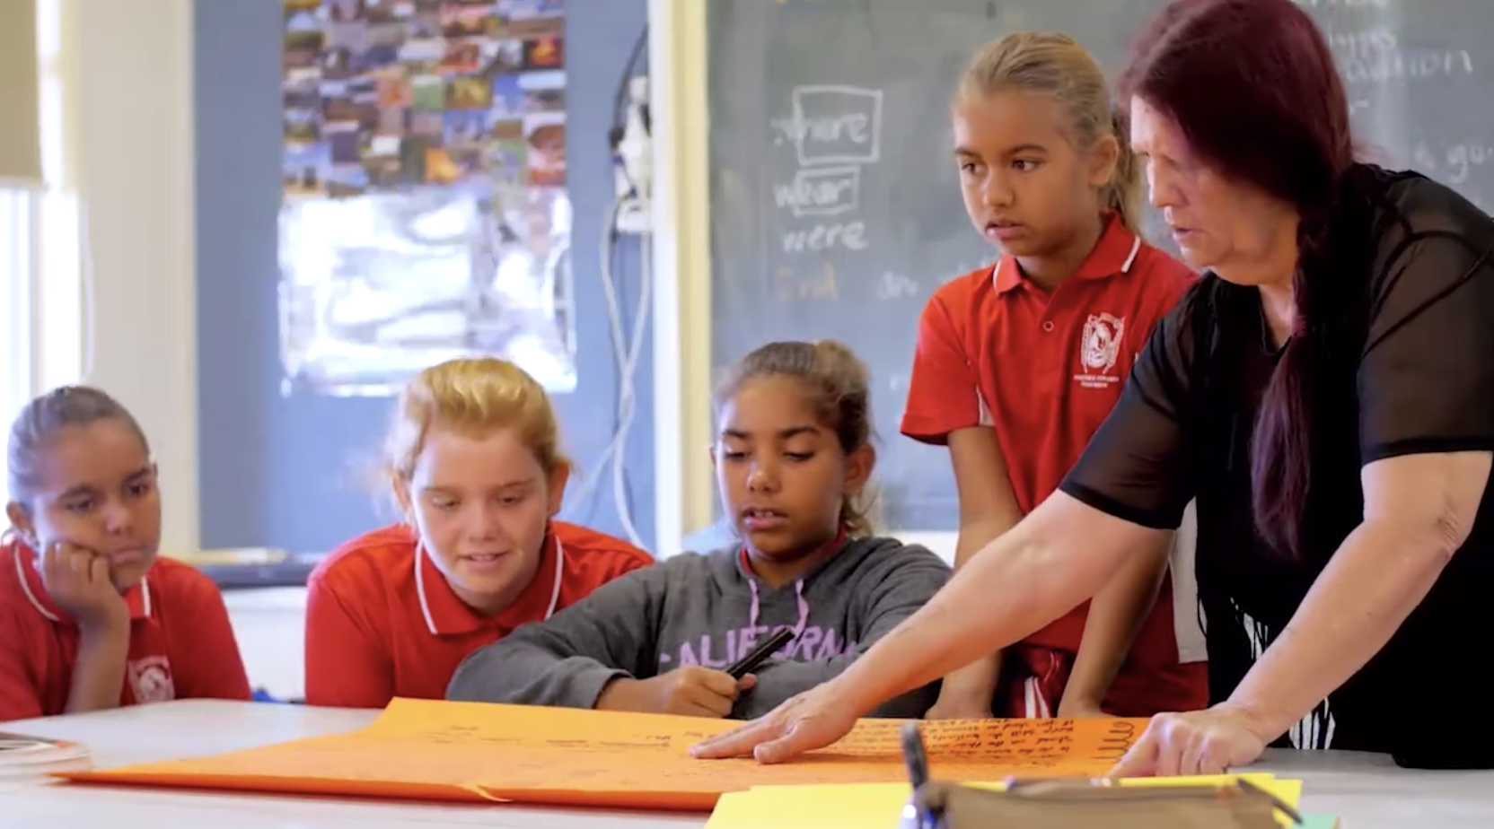
Let’s Consider Using Language as a Resource in your picture story books
https://www.youtube.com/watch?v=2a2E695JTe8
My WA: Story books in Aboriginal English - Kondinin

Slide 11
The Curriculum Plan
Whole year
Overview of topics & assessments – Big picture
Curriculum Plan
Overview of topic – includes list of activities, handouts/templates*, more assessment detail – Middle picture
Lesson Plan
Fine detail – includes activity instructions, timings, groupings of students, lesson success criteria etc. – Close up
* Handouts/templates can be placed in the appendices
Notes:
Various level of planning

Slide 12
Assignment 2
PART A – GROUP | PART B – INDIVIDUAL
Storybook | Final Reflection
Curriculum Plan (using the storybook to teach your students narrative genre)
* Overall presentation, including proof reading
Upload to Moodle 3 documents
2 documents that your group have produced - Storybook + Curriculum plan (one upload per group_
1 document that you have personally produced – final reflection
Notes:
Under Moodle Assessment information – under the upload your assessment

Slide 13
Group work
Explore the Supported Reading resources under Moodle Topic 10
What meaningful supported reading activities can you add to your curriculum plan
What aspects of student learning will you focus on e.g. enjoyment, vocabulary, reading for fluency, comprehension, learning about the narrative genre

Slide 14
FOR NEXT WEEK
Continue working in your group to finish your picture story book & curriculum plan
Remember to complete your individual journal for Week 10 supporting it with the unit readings
Next week we will look at
Assessment for, of and as learning

