Slide 1
Independent Writing and differentiation teaching and learning cycle
Week 9 – EDF 1205. 2020

Slide 2
The Curriculum Plan
Whole year
Overview of topics & assessments – Big picture
Curriculum Plan
Overview of topic – includes list of activities, handouts/templates*, more assessment detail – Middle picture
Lesson Plan
Fine detail – includes activity instructions, timings, groupings of students, lesson success criteria etc. – Close up
* Handouts/templates can be placed in the appendices
Notes:
Various level of planning

Slide 3
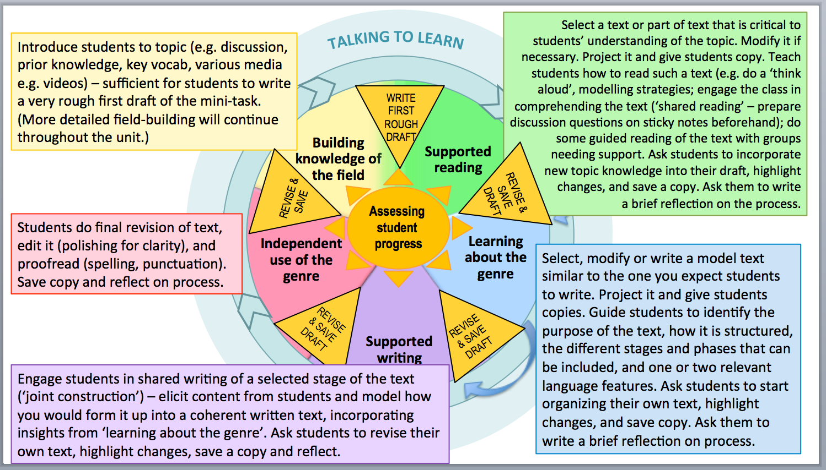

Slide 4
Independent composition
Independent composition takes place when students are ready to work on their own texts drawing on the understandings about genre and language developed through modelling and guided practice.
During the independent writing stage, the teacher’s role is to guide the students in their composition, supporting them to creatively design and compose their texts independently. For some less confident students, this might mean closely following a model but for most students it will involve a creative turn and an expansion of their repertoire.
Source: www.education.vic.gov.au/school/teachers/teachingresources/discipline/english/literacy/readingviewing/Pages/teachingpraccycle.aspx#link46

Slide 5
Structured Support –with:
Authorial features - meaning
Editing
Peer conferencing
Teacher conferencing
Secretarial features –
Accuracy
Proof reading

Slide 6
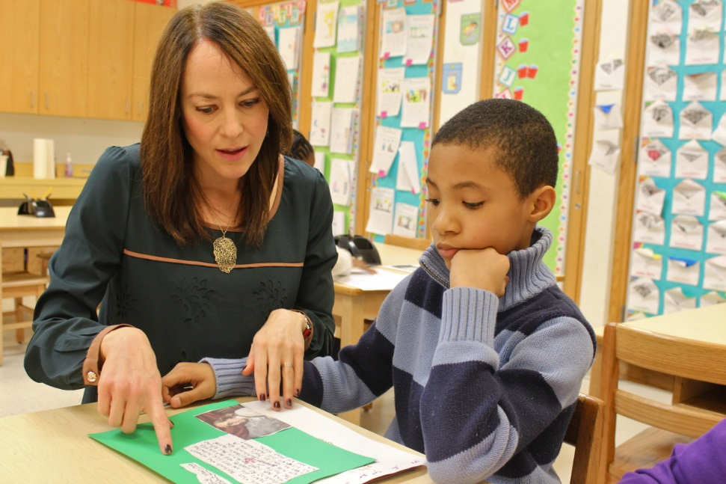
Teacher Conferencing
Working with individual students and/or groups of students to help draft, edit and proof read their writing
Notes:
Discuss video clip

Slide 7
Teacher Conferencing
Writing Conferences - Upper Primary
BREAKOUT ROOM
As you watch the video linked, what strategies do you see the teacher using when conferencing with the students?
https://padlet.com/karen_barley/independentwriting
Notes:
Discuss video clip

Slide 8
Proof reading
Reading for:
Sentence level
Punctuation
Grammar
Spelling
Overall coherence
What strategies do you use to proof read?
Notes:
Read out loud
Swap with peer
Reading backwards

Slide 9
Narrative Genre
What are the features of narrative genre?
Theme
Plot – orientation, complication & resolution
Setting
Character development
Language features

Slide 10
Recapping the tools to investigate the language of stories:
To interpret the THEME of the story by looking at how certain meanings are given significance in developing a message.
To explore the basic elements of PLOT by identifying how the story moves through typical stages such as Orientation, Complication and Resolution;
To understand how the story ‘works’ in greater detail by identifying the PHASES within the stages;
Notes:
Simple sentence or phrase for theme
Demonstrate the iterative nature of the teaching and learning cycle

Slide 11
Recapping the tools to investigate the language of stories continued…
To observe how various aspects of SETTING (natural, built, time, historical, social) participate in developing the meaning of the story;
To investigate how CHARACTERS are brought to life through description of their physical characteristics and personality along with how they behave (doing, thinking, feeling, interacting).
Notes:
Simple sentence or phrase for theme
Demonstrate the iterative nature of the teaching and learning cycle

Slide 12
Revisiting the narrative structure of the coat consider your own picture story book

Slide 13
The coat: let’s revisit
What would you say is the theme of The Coat?
How do the complication and resolution contribute towards the theme of the story?
THEMES
e.g.
Growth in confidence
The mutual support in fulfilling potential – becoming one

Slide 14
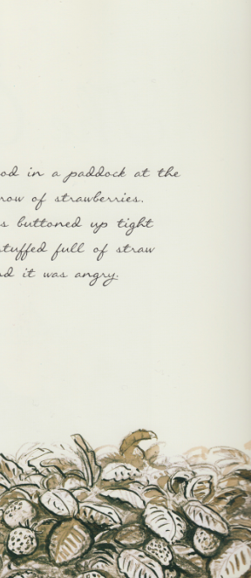
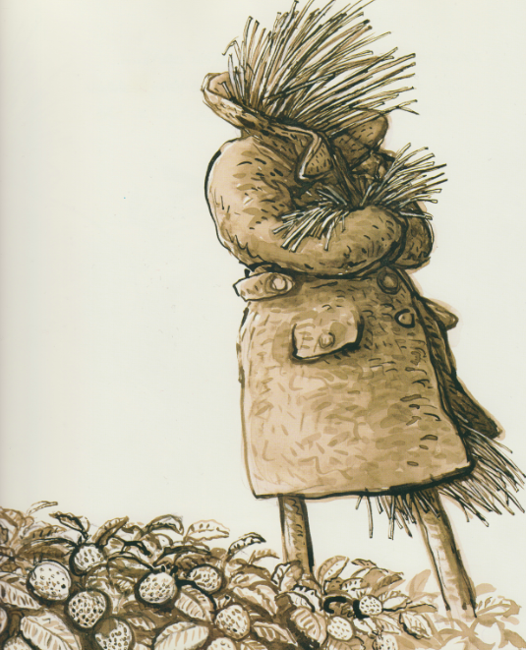
ORIENTATION
The coat stood in a paddock at the end of a row of strawberries.
It was buttoned up tight and stuffed full of straw and it was angry.
Initial setting
Introduction to character

Slide 15
Complication – Man feeling disappointed and unwilling to take initiative; coat feeling angry at not being useful
Resolution – Man and coat become one, fulfilling the man’s potential and giving the coat back its purpose

Slide 16
Breakout Room:
10 mins – in your own group, use the questions from Slide 18
15 mins - Two groups together to share, compare & give feedback. Use the questions from Slide 19

Slide 17
Read your text Self Review
Identify its theme
Identify the orientation, complication & resolution
Identify (meta)language features (1st, 2nd, 3rd person, verbs in present, past, future tense, use of adjectives, verbs, adverbs etc)
Feedback & reflection: How does the theme, orientation, complication & resolution relate to each other?
What gaps can you see? Is there anything that needs to be added, deleted or altered to make the story more cohesive?

Slide 18
Read your NEIGHBOUR’S text Peer Review
Identify its theme
Identify the orientation, complication & resolution
Identify (meta)language features (1st, 2nd, 3rd person, verbs in present, past, future tense, use of adjectives, verbs, adverbs etc)
Feedback & reflection: How does the theme, orientation, complication & resolution relate to each other?
What gaps can you see? Is there anything that needs to be added, deleted or altered to make the story more cohesive?
Notes:
2 groups swap stories

Slide 19
REVIEWING THE CHARACTERS & SETTING

Slide 20
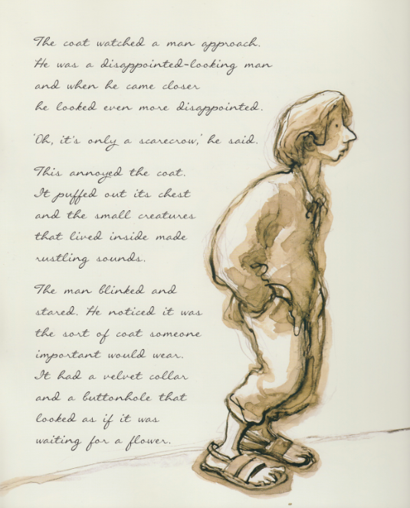
The coat watched the man approach.
He was a disappointed-looking man
and when he came closer
he looked even more disappointed.
‘Oh, it’s only a scarecrow,’
he said.
Introduction to character
Reaction
This annoyed the coat.
It puffed out its chest
and the small creatures that lived inside made rustling sounds.
The man blinked
and stared.
Notes:
There are multiple ways to reflect on character development and setting

Slide 21
Activity
Can you find evidence from your text of how the characters are being developed?
What resources have you used?

Slide 22
Scaffolding questions for reviewing the story
How does the reader get to know the characters? (Evidence from the text: what they do, what they say, what they think, physical description)
How and why do they change through the story? (Evidence from the text: eg change in attitude)
How have you used language to create this story world? (eg discuss some particularly vivid examples)
How do you illustrate using images to create the story world? (eg discuss relating to setting, character development, feelings, engagement)

Slide 23
Authors make very deliberate choices in developing their characters:
how many characters are there? What relationships do they have?
who is the central character (the protagonist)? What age? Which gender? What qualities? Sympathetic or unsympathetic?
is there be an antagonist?
how does the author’s choices contribute towards the development of the complication?
how is empathy for the characters developed?
how are the characters fleshed out?

Slide 24
Activity
Can you find evidence in your text of how the setting is being developed?
What resources have been used?
Use next slide as a guide

Slide 25
SETTING
How is the physical setting of the story built?
How is the historical setting of the story represented?
How is a particular social setting created?
What kind of ‘world’ is created (eg fantasy, dystopian, science fiction, adventure, romance)?
How do these settings change as the story develops?
How significant is the setting to the storyline? (eg if you change the setting, how else does your setting change?)

Slide 27
Group work

Slide 28
Assignment 2
PART A – GROUP | PART B – INDIVIDUAL
Storybook | Individual reflection (linked to the literature)
Curriculum Plan (using the storybook to teach your students narrative genre)
* Overall presentation, including proof reading
Upload to Moodle 3 documents
2 documents that your group have produced - Storybook + Curriculum plan (one upload per group_
1 document that you have personally produced – weekly reflections
Notes:
Under Moodle Assessment information – under the upload your assessment

Slide 29
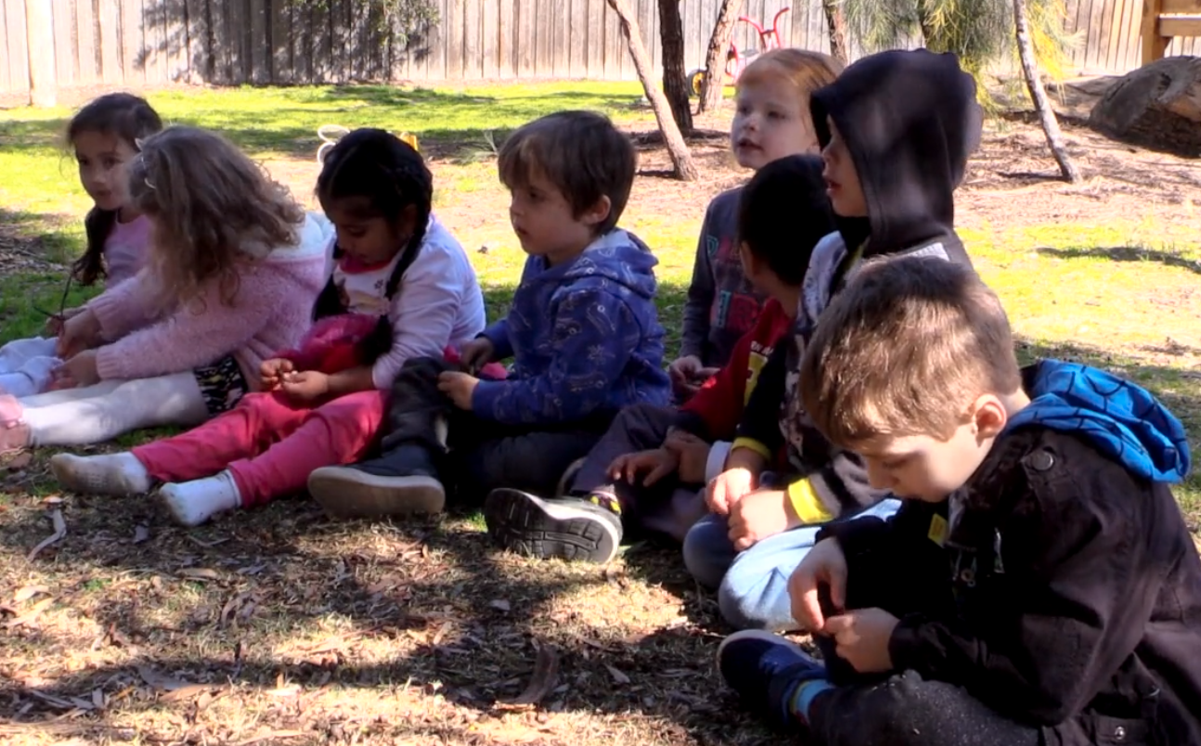
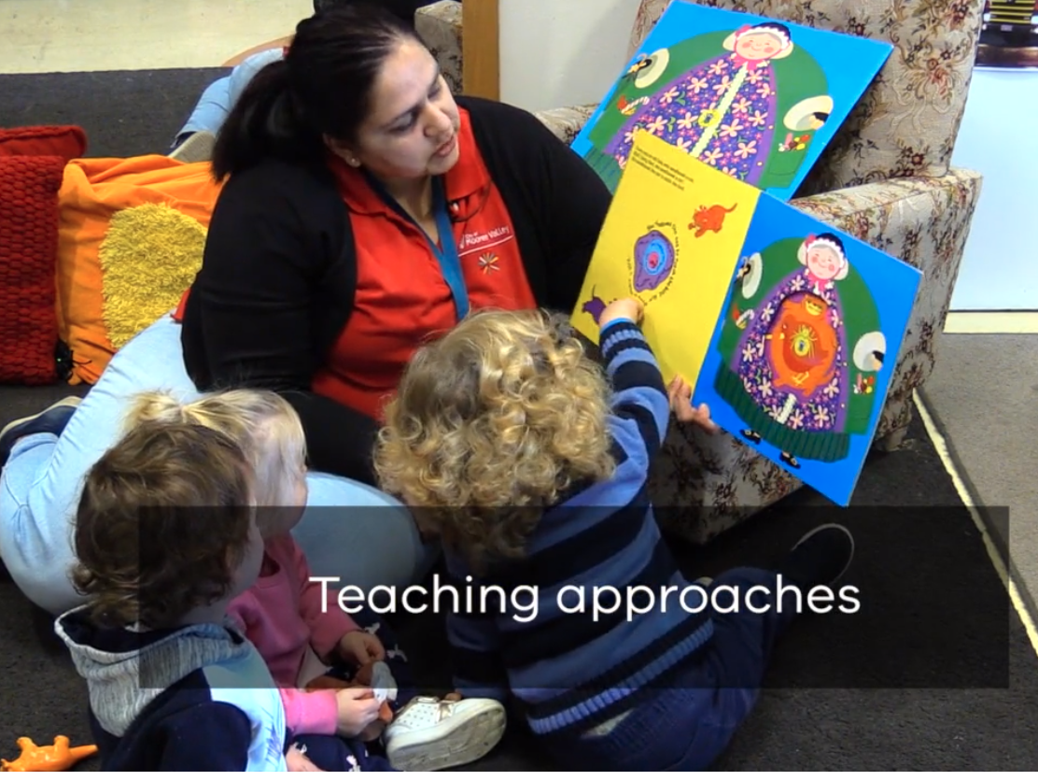
DIFFERENTIATION:
Have you considered it in your teaching-learning cycle plan?
This video features Professor Lorraine Graham discussing differentiated teaching and learning.

Slide 30
AFTER WatchING the videoclip in previous slide:
Reflect on the concept of differentiation discussed by Professor Lorraine Graham:
What explanation of differentiation is provided in the video?
How does this relate to your own ideas about differentiation?
What were some kinds of differentiation practices identified in the video?
What are some key examples of differentiation you use in your teaching?
https://www.education.vic.gov.au/school/teachers/teachingresources/discipline/english/literacy/Pages/expertvideos.aspx

Slide 31
FOR NEXT WEEK
Continue working in your group to finish your picture story book & curriculum plan
Remember to complete your individual journal for Week 9 supporting it with the unit readings
After the mid semester break we will look at Assessment for, of and as learning

